Slide 1

Intelligent Academic Advisor --An Intelligent application provides smart solutions to Penn State
Meng Su (Team Lead)
Xiaoyu (Allen) Zhou (Technical Lead)
Dawn Coder(Subject Matter Lead)
Daria Cook (Corpus Manager)
Krystal Elliott(Corpus Developer,Presenter)
Guangxuan Zhang
Richard Zhao

Slide 2
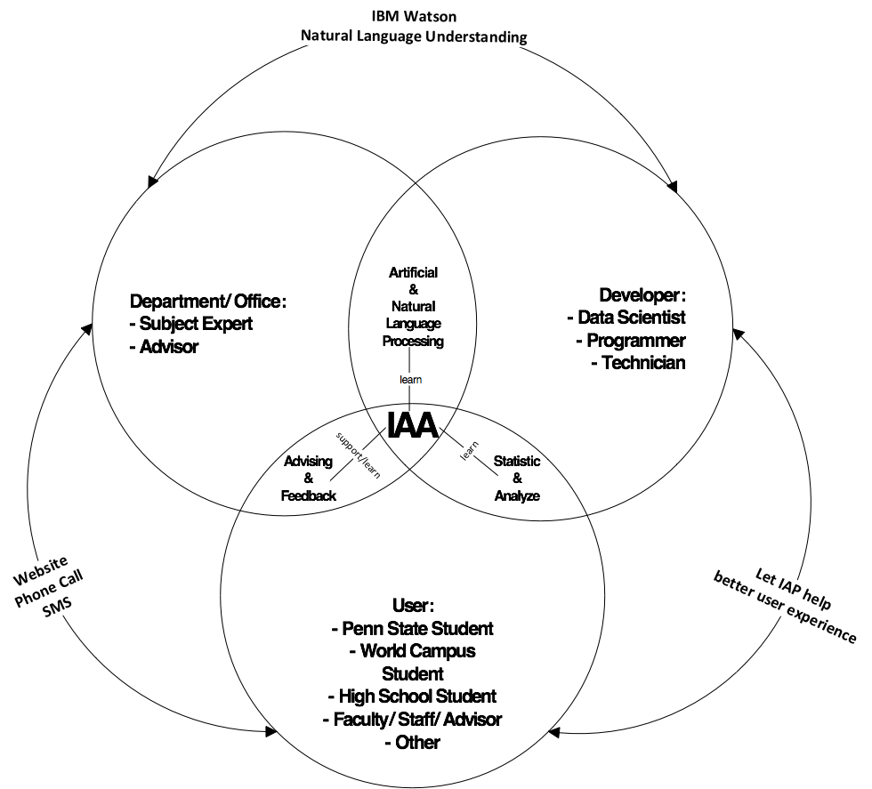
Project Overview

Slide 3
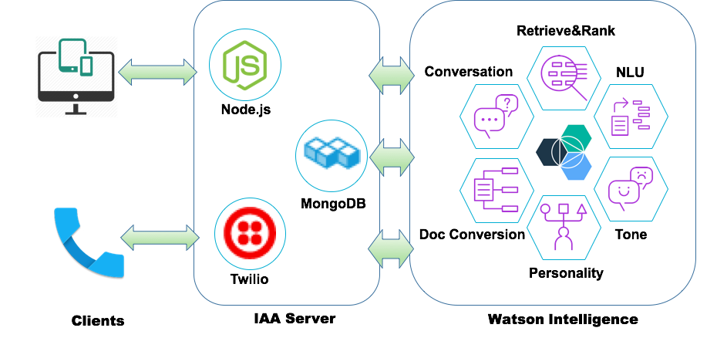
Architectural Design

Slide 4
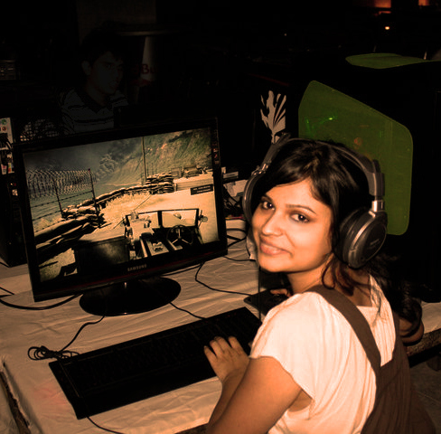
Project Demos
It starts with a story of Alice
- A high school student is considering her future. ……

Slide 5
Alice is trying to decide which colleges to apply to. She is considering a few factors.
She loves video games.
She wants to be involved in clubs on campus.
She is from Philadelphia, but she wants to live somewhere “green”.

Slide 6
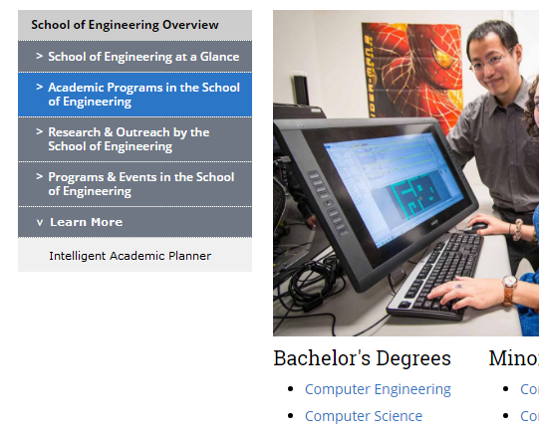
She follows this page’s “Learn More” link to the “Intelligent Academic Advisor”

Slide 7

She is directed to a page with a search bar.
The top of the page reads:
ASK ANYTHING ABOUT BEHREND’S CSSE PROGRAM
There is a “Question Feed” on the side of the page that has questions like: “What is Erie like?” and “What minors can I take?”

Slide 8
Questions
Website:
What is CSSE?
What is Software Engineering?
Then what course I will learn for Software Engineering online degree?
Do I need to be good at math for Computer Science?
Does Behrend have tutors?
Do software Engineer make video games?
Are there other clubs at Behrend?
IAP Call Center:
What is the crime rate at Behrend?
Website:
Is there a club for game developers?
Tell me more about Penn State Behrend.

Slide 9
More Questions via Phone Interface
Alice calls her father John over to tell him that Behrend sounds pretty cool. His questions are:
What is Behrend's tuition?
What scholarships are offered at Behrend?
What is the crime rate at Behrend?
Are the engineering programs at Behrend accredited?
What is the salary of a Computer Scientist?

Slide 10
Questions via Phone Interface
Her mother is not good at typing so instead she dial the IAP call center and ask following questions.
What is Erie like?
Tell me more about Behrend.

Slide 11
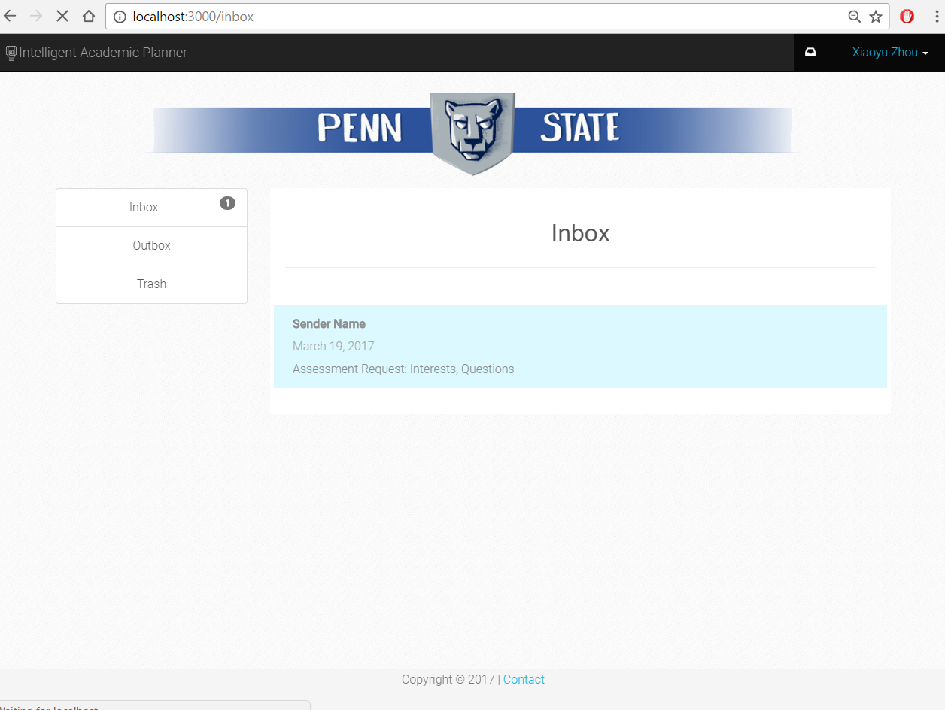

Slide 12
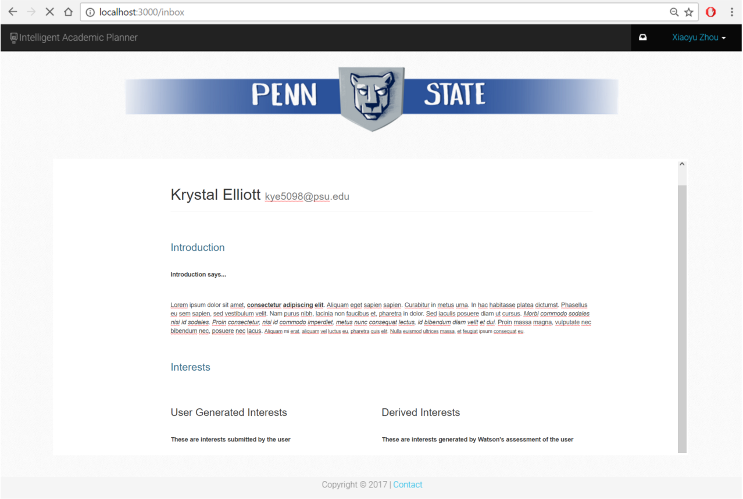

Slide 13
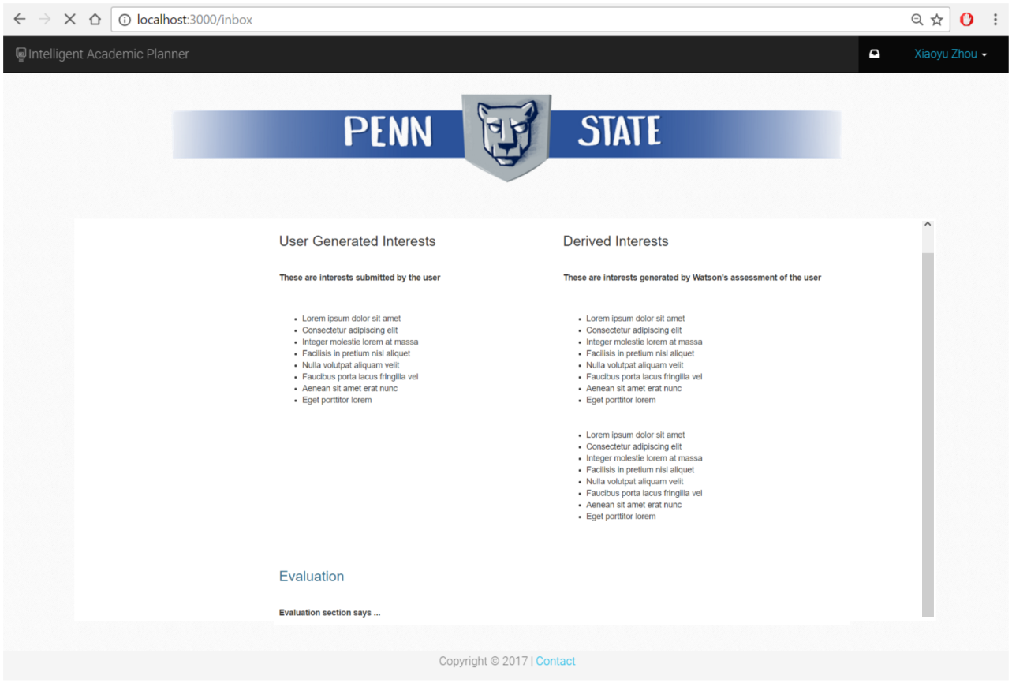

Slide 14
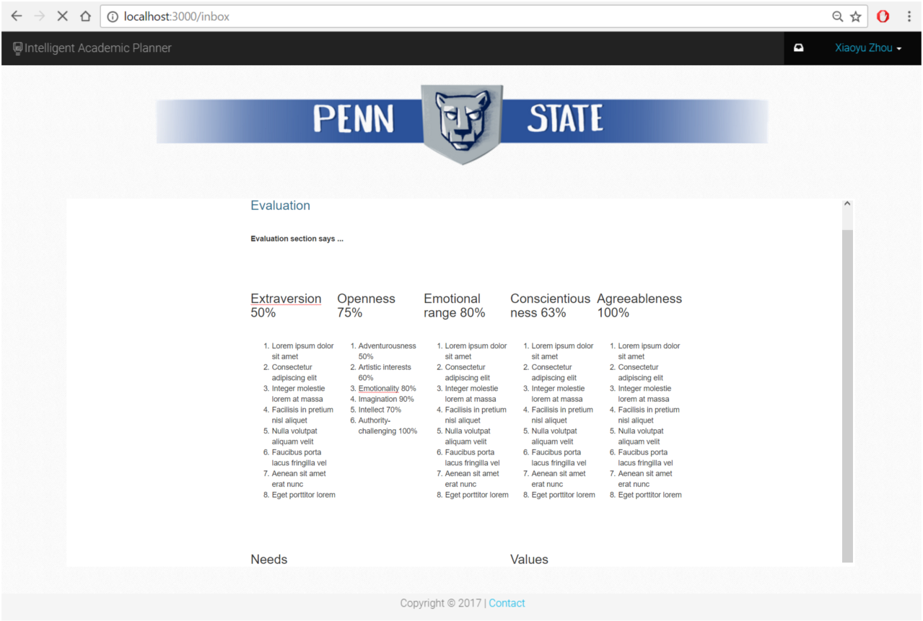

Slide 15
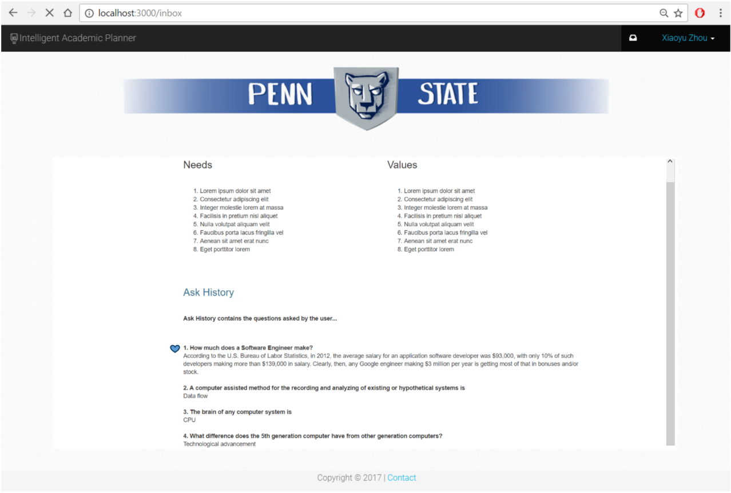

Slide 16
Thank you!

